Slide 1

Advanced x86: BIOS and System Management Mode Internals SMI Suppression
Xeno Kovah && Corey Kallenberg
LegbaCore, LLC

Slide 2
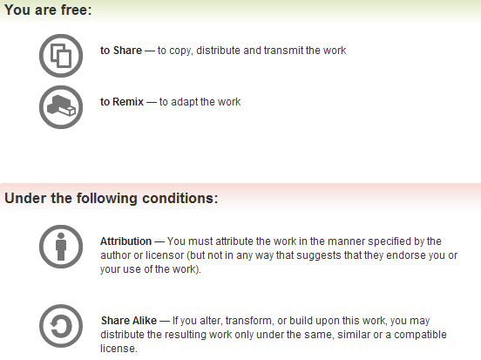
All materials are licensed under a Creative Commons “Share Alike” license.
http://creativecommons.org/licenses/by-sa/3.0/
Attribution condition: You must indicate that derivative work
"Is derived from John Butterworth & Xeno Kovah’s ’Advanced Intel x86: BIOS and SMM’ class posted at http://opensecuritytraining.info/IntroBIOS.html”
Notes:
Attribution condition: You must indicate that derivative work
"Is derived from John Butterworth & Xeno Kovah’s ’Advanced Intel x86: BIOS and SMM’ class posted at http://opensecuritytraining.info/IntroBIOS.html”

Slide 3
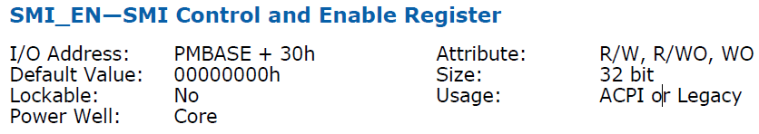
SMI Suppression
SMM stands as the first line of defense for protecting the BIOS flash from being overwritten
We’ll cover how in the flash BIOS portion of the course
What if the attacker simply suppressed SMI from being generated?
They can, if the system isn’t locked down properly:
I/O Controller Hub Family 9

Slide 4

SMI_EN: SMI Control and Enable Register
Located in the Power Management IO Registers (memory-mapped at PMBASE defined in LPC D31:F0)
The SMI_EN register can enable or disable some very specific instances of SMI# or globally enable/disable all SMI#
Shown above is the Global Enable/Disable for SMI#

Slide 5
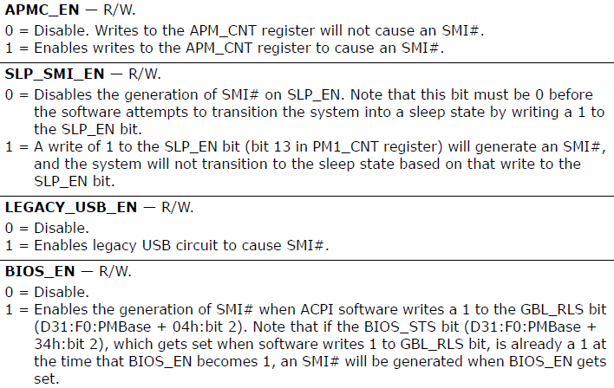
SMI_EN
We can disable the generation of SMI# on writes to IO port 0xB2
And a slough of others (BIOS_EN refers to BIOS being able to receive ACPI “messages”, it has nothing to do with enabling/disabling BIOS itself)

Slide 6
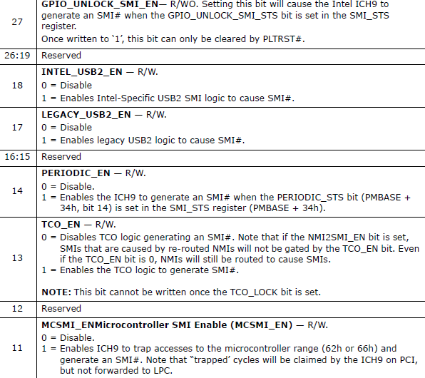
SMI_EN
SMI_EN provides a lot of control over the generation of SMI#
It can also enable/disable that periodic generation of SMI#
You get the idea…

Slide 7
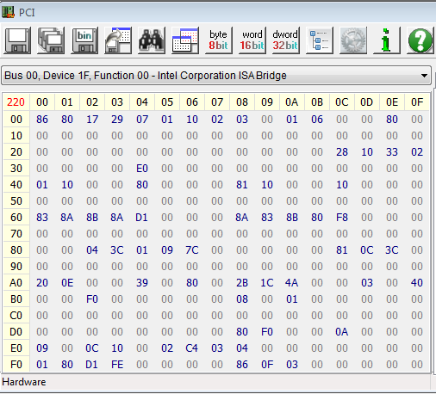
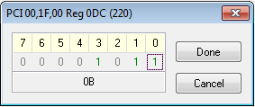
Demo: SMI Suppression
BIOS_CNTL register
As we know, we (should be) unable to assert bit 0 in the BIOS_CNTL register located in LPC D31:F0, offset DCh
Let’s “fix” that!

Slide 8
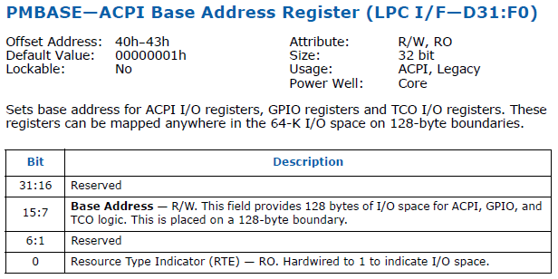
Demo: SMI Suppression
Locate the PMBASE address from LPC D31:F0, offset 40h
This is mapped to the I/O address space, as indicated in the Base Address register description

Slide 9
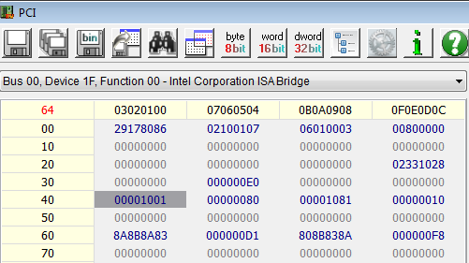
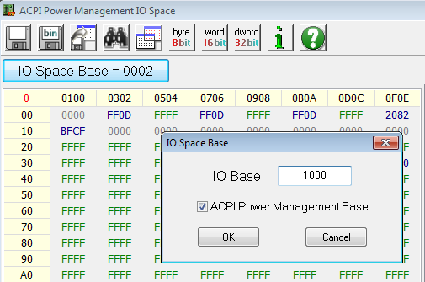
Demo: SMI Suppression
In this case we can see it is mapped to I/O starting at address 0x1000
Open up an I/O ports window and enter 0x1000
Be sure to check ACPI Power Management Base
On some systems not doing this causes lockups or system crashes

Slide 10
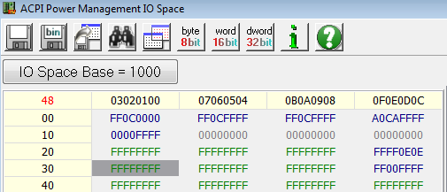
Demo: SMI Suppression
The bit to suppress global SMI# is at bit 0 in the SMI_EN register located at PMBASE + 30h
It looks like uninitialized space, but everything is enabled
Just not locked down

Slide 11
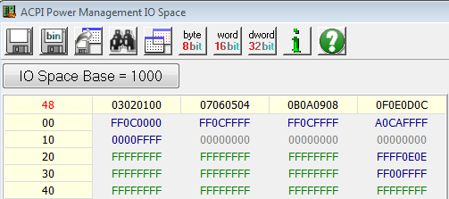
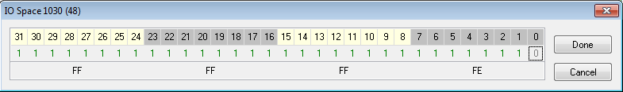
Demo: SMI Suppression
Commence SMI# suppression!
De-assert bit 0 so that SMI_EN is FFFF_FFFEh

Slide 12
Demo: SMI Suppression
BIOS_CNTL register
Now with SMI# suppressed we can enable writes to the BIOS flash by asserting bit 0 in the BIOS_CNTL register
We’ll cover this in more detail in the next section

Slide 13
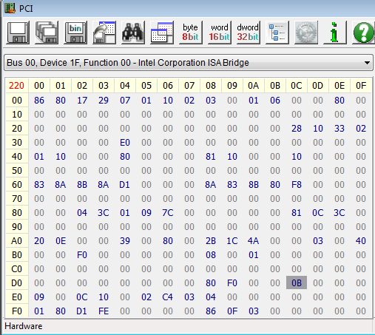
Demo: SMI Suppression
Notice that bit 0 remains asserted now whereas before disabling SMI# it would have been reset to 0
Now we can write to the BIOS. This is very bad.

Slide 14
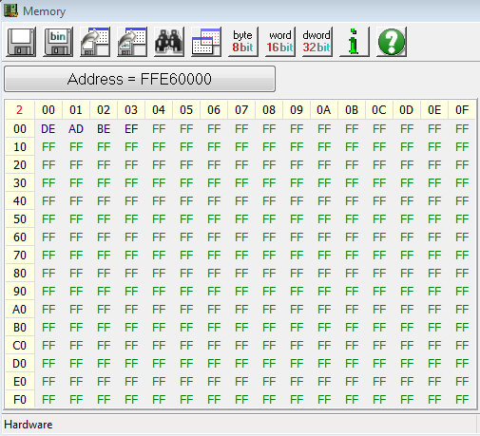
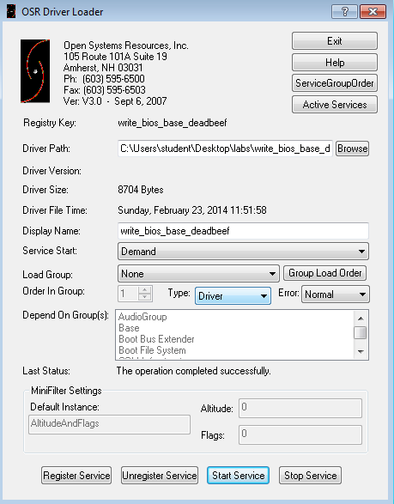
Demo: SMI Suppression
Running the write_bios_base_deadbeef.sys writes to the BIOS base to prove this point

Slide 15
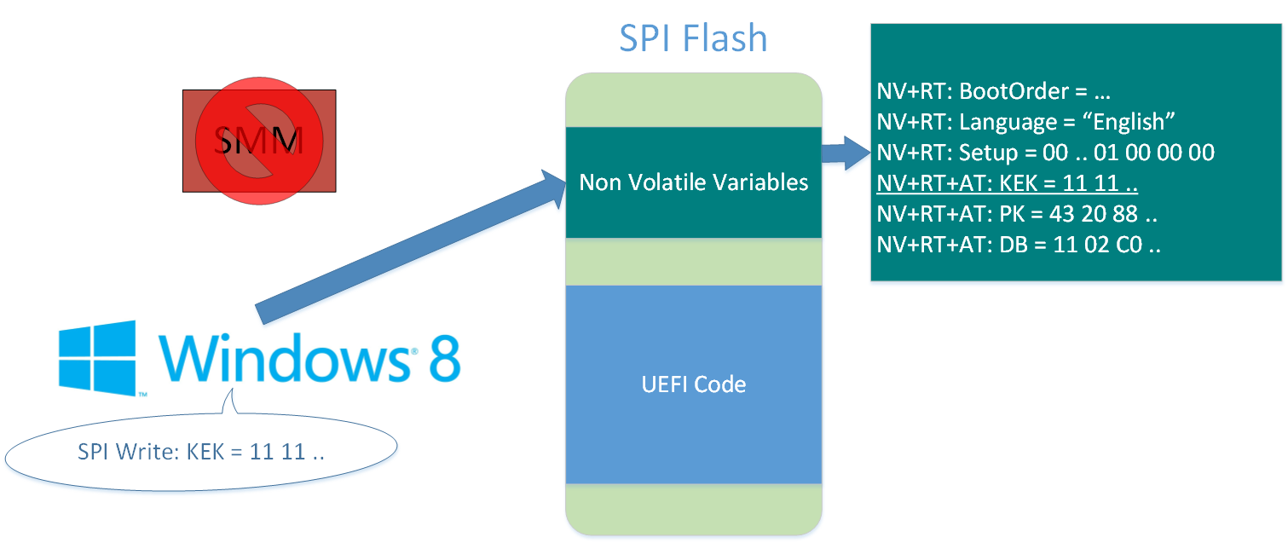
Demo Video: Charizard
Ring0 can modify authenticated EFI Variables, which allows trivial bypassing of Secure Boot
We’ll cover this in the UEFI secure boot portion of the class. For now just take my word for it: this is not good
Notes:
Note, this is from our public released charizard talk

Slide 16
SMI Suppression
As we’ll see in the next section, there is one secondary defense that could still work to prevent an attacker from being able to flash the BIOS under these circumstances
However they can’t be used to protect the UEFI variables because those must always be writeable
Locking down the SMI_EN register is something that vendors don’t really know about:
3216 of 8005 (~40%) systems measured did not have SMI_LOCK set
The numbers are much higher if you rollback the BIOS to a vulnerable revision, which is typically permitted

Slide 17
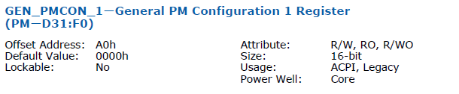

SMI Suppression Prevention 1: GEN_PMCON1
GEN_PMCON1 is located in the LPC D31:F0 Power Management registers
The vendor must (must must!) assert SMI_LOCK in the GEN_PMCON_1 register
Don’t give attackers the option of suppressing SMI#
Especially since the system depends on SMM to protect the BIOS Flash!!!

Slide 18
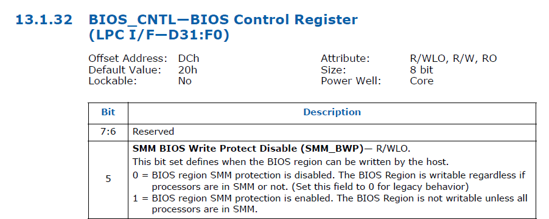
SMI Suppression Prevention 2: BIOS_CNTL.SMM_BWP
We’ll cover this register during the BIOS flash portion of the course
Raises the security level of the platform
Suffice to say this is a very useful (newish) feature
That isn’t utilized very often

